Slide 1
MULTI-AGENT RL ENVIRONMENT

Slide 2
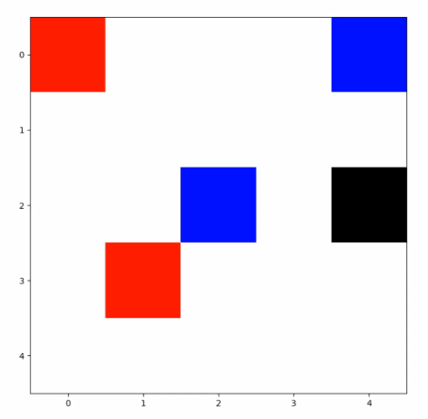
Background
Mimics real-world situation, where people both compete, and cooperate for common goal.
Consider driving: when should we yield?
Multi agents make the world more complex:
The state changes depending on other agents.
While learning, the state distribution probabilities is affected by other agents’ action, which is also changing rapidly.

Slide 3
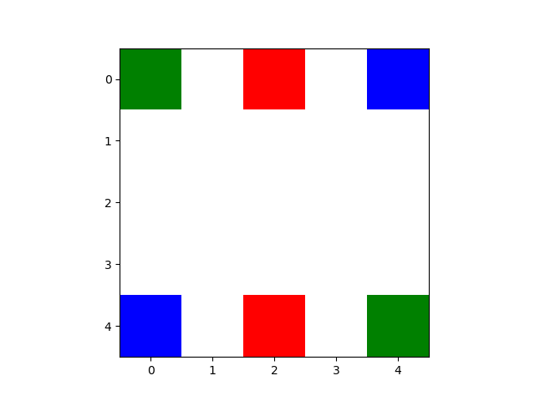
The environment
Custom-defined grid environment
Agents start at the bottom, and navigate to the top
The destination are designed so the paths are intersected.
Following the presentation, we will deal with a blank 5x5 grid and 3 agents.
An example of a 5x5 grid with 3 agents.

Slide 4
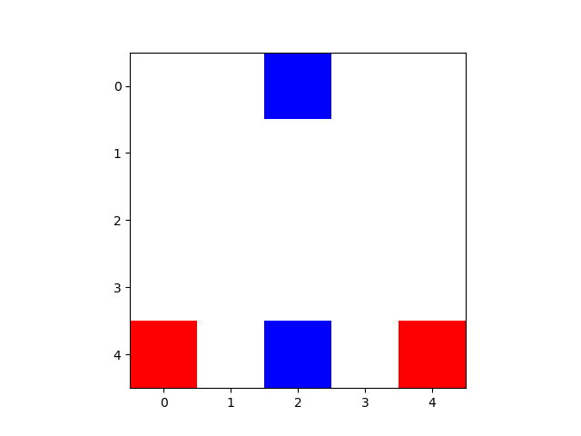
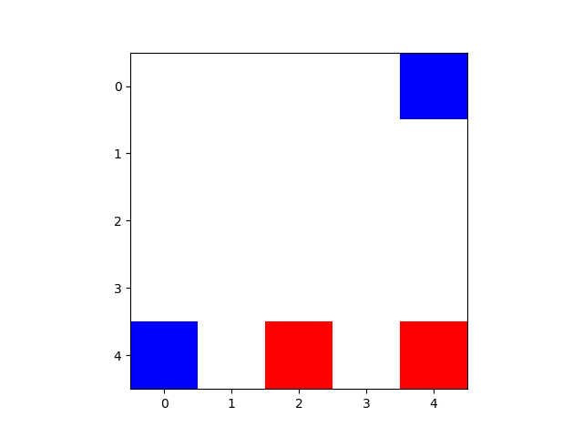
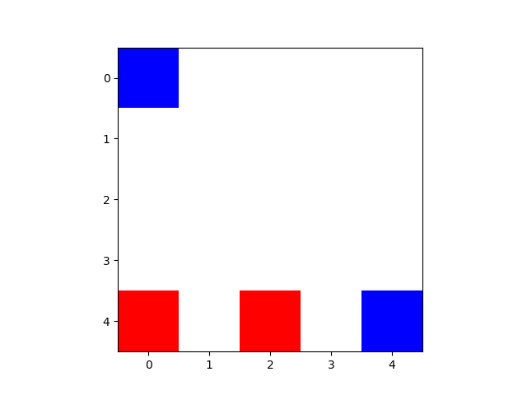
Rewards, Observation and Action Space
No-OP, Left, Right, Up, Down
Can observe the grid, the current locations of all agents, and the target.
Independent reward:
-1 at every steps, except at the target.
-5 for illegal move.

Slide 5
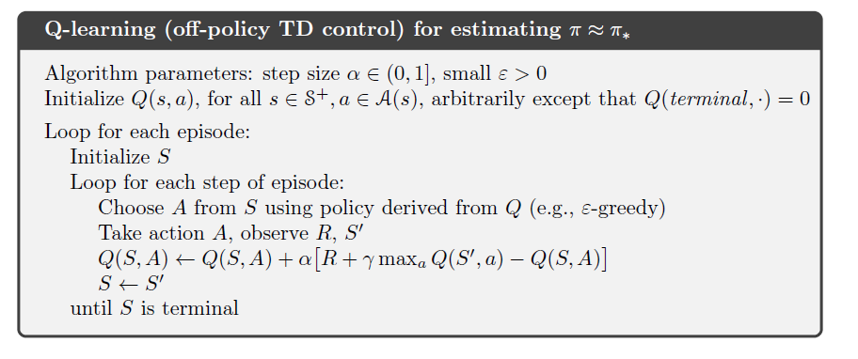
Q-Learning
Simple model-free, TD control method.
Learns the state-value action.
Have to manually set the exploration-exploitation parameter.
Suffers when the dimension is too large.

Slide 6
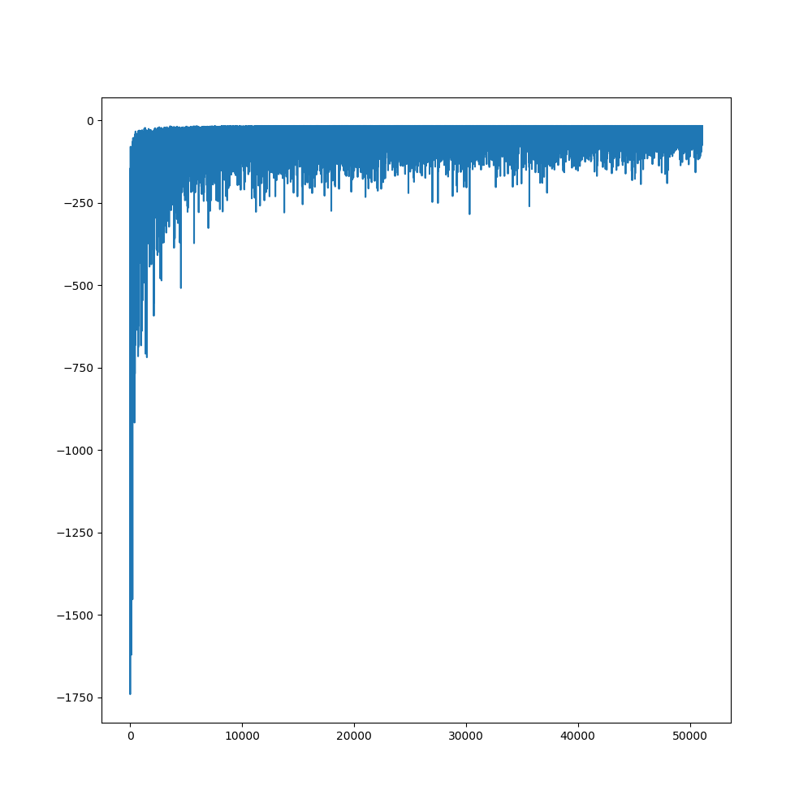
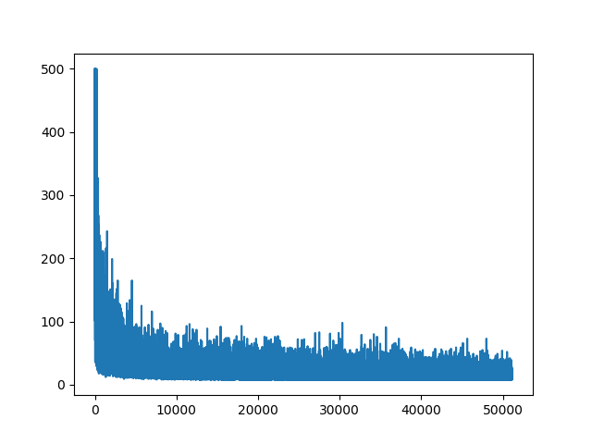
Training and Results on Q-Learning
Number of steps until done
Cumulative reward for all agents
Trained on 1 million steps, with epsilon rate of 0.1
Each epoch is limited to max 500 steps

Slide 7
Deep Q-Learning
Approximate the Q function using (usually) Neural Network.
Needs a replay buffer to ensure independent, non-correlated training samples.
Require a lot of fine-tuning parameters:
Exploration rate
Update frequency
Replay buffer size
Etc
Model design is also complicated, and dependent on the task.
Hardware requirement.
To address the two last issues, we opt for a small environment, and a small model.

Slide 8
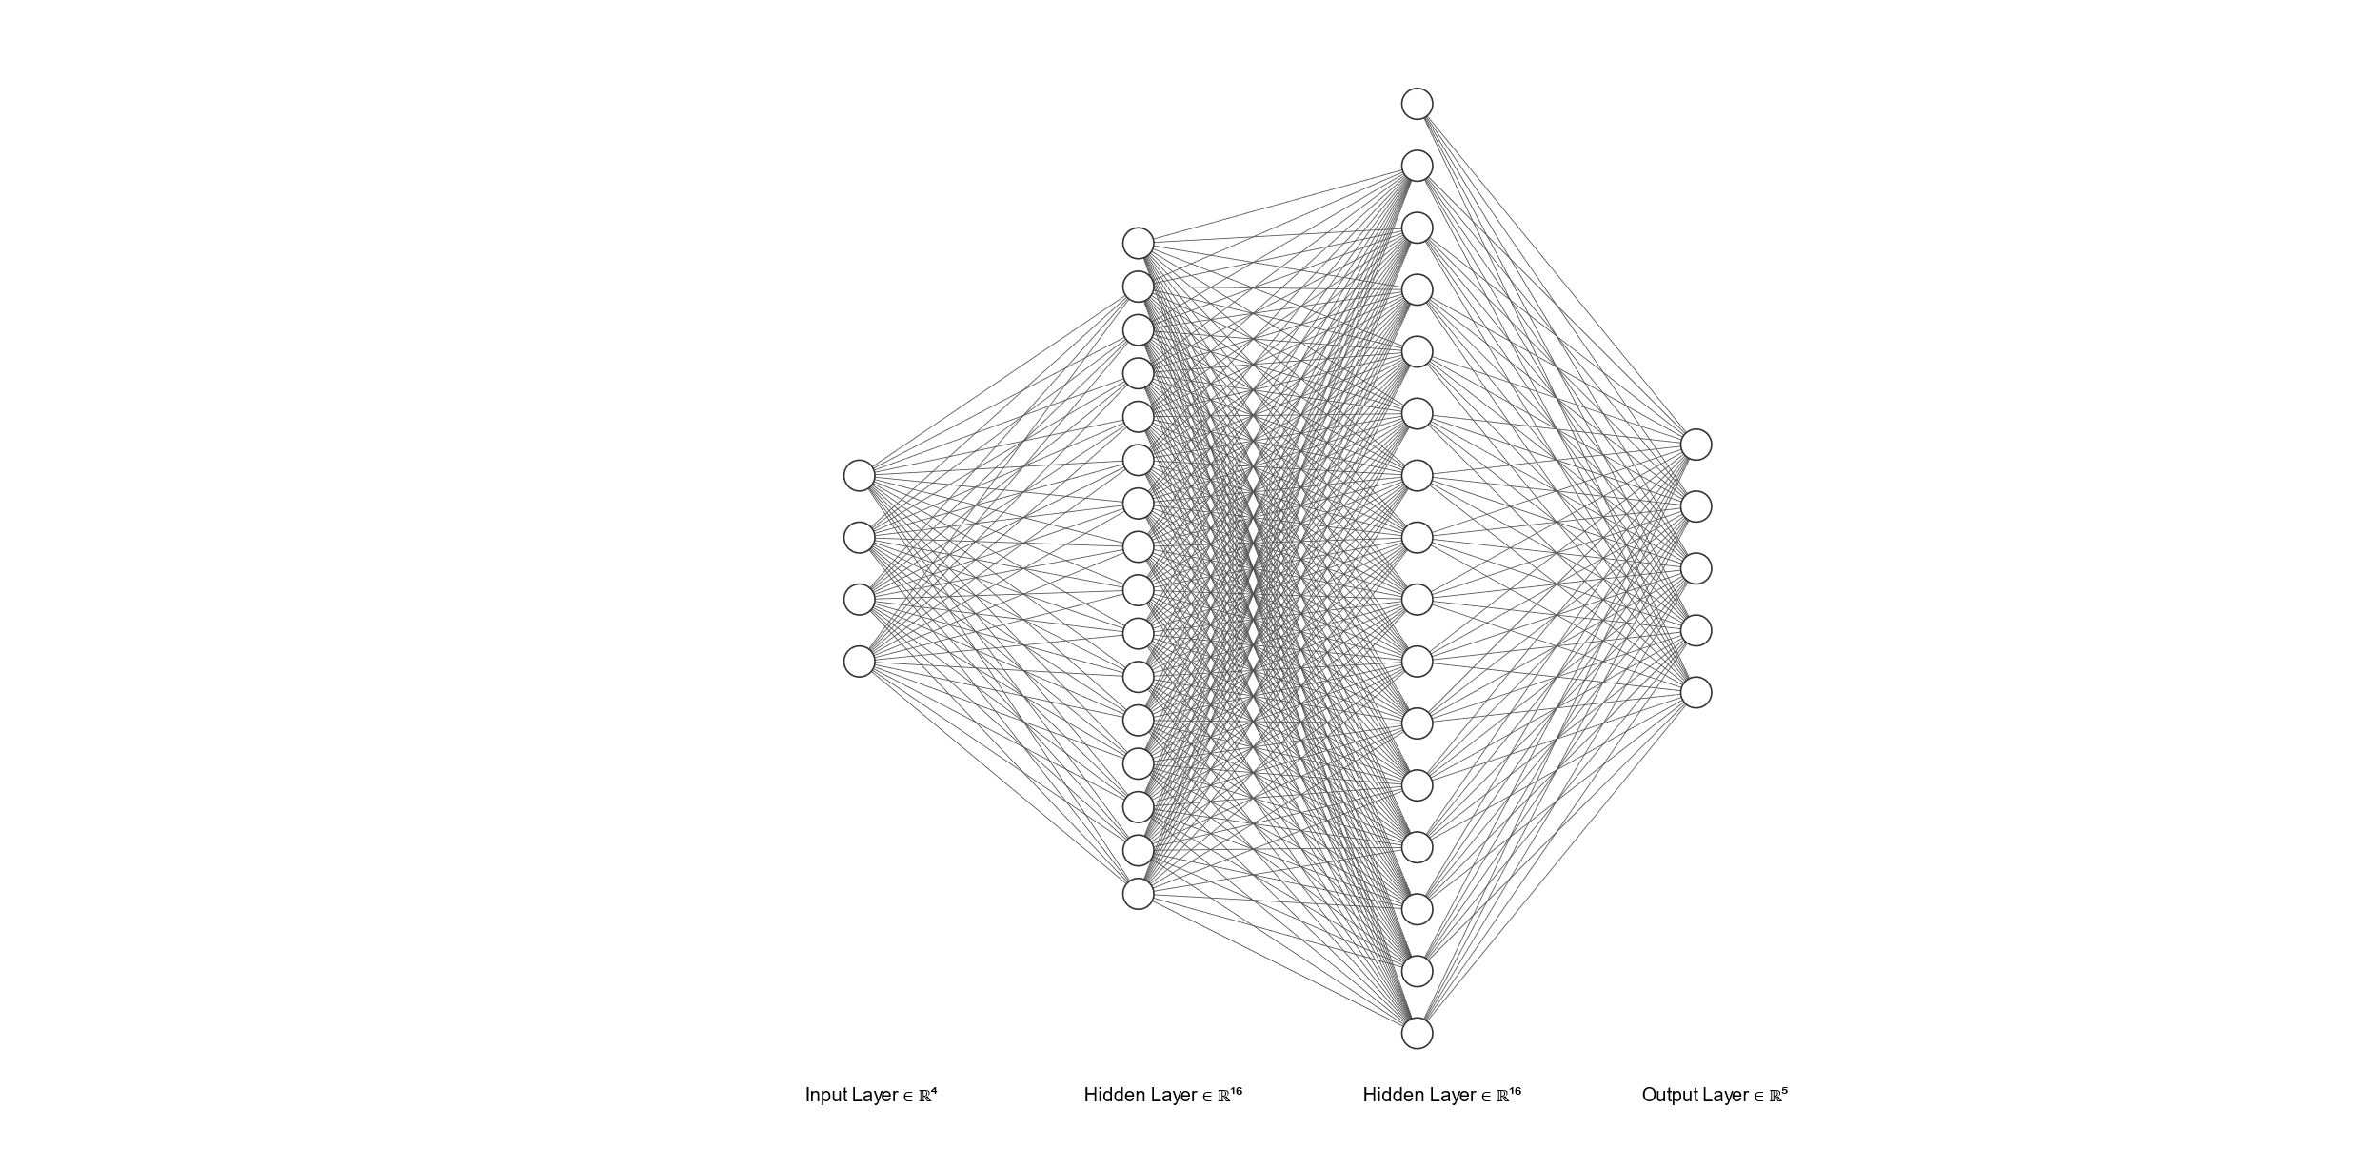
Model Architecture
The FCN architecture (model not drawn to scale).
Simple FCN with two layers, each of size 128.
Using Rectified Linear Unit activation function.

Slide 9
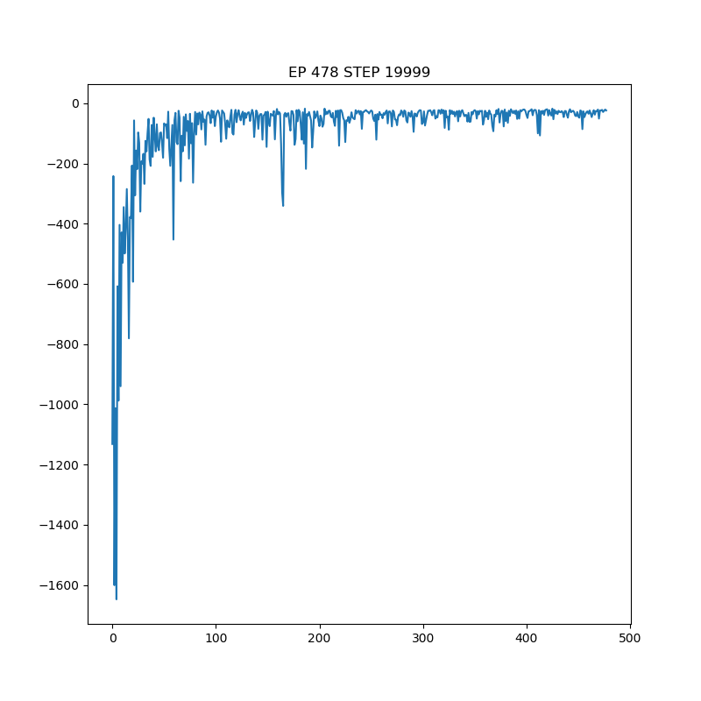
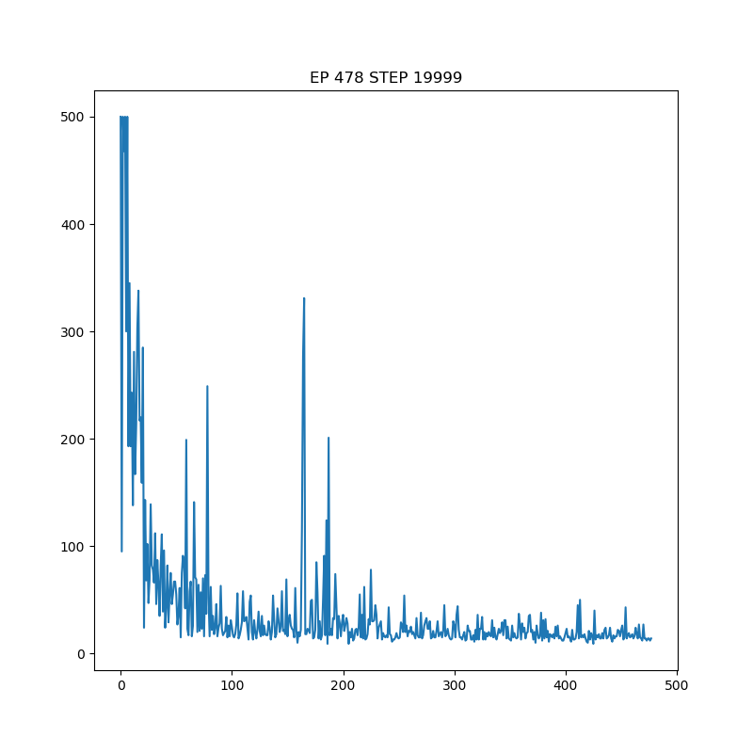
Training and Results
Cumulative Reward
Trained on 20000 steps.
Episode terminate at max 500 steps.
Linear decay epsilon from 1 to 0.01 in 10000 steps.
Update freezing weight every 1000 steps.
Step until solved

Slide 10
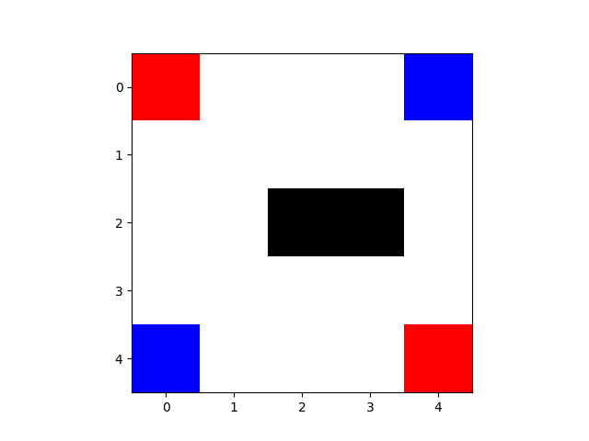
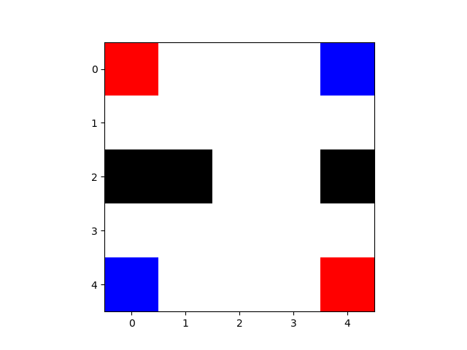
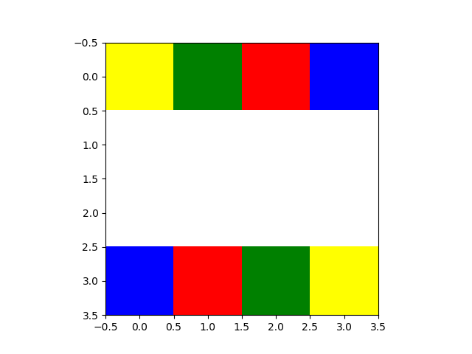
Adding flavor to the mix
Can our simple model solve more complex tasks?
Showing the varieties of the environment.
Maximum of 4 agents (when render is needed).
Adding randomized obstacle.

Slide 11
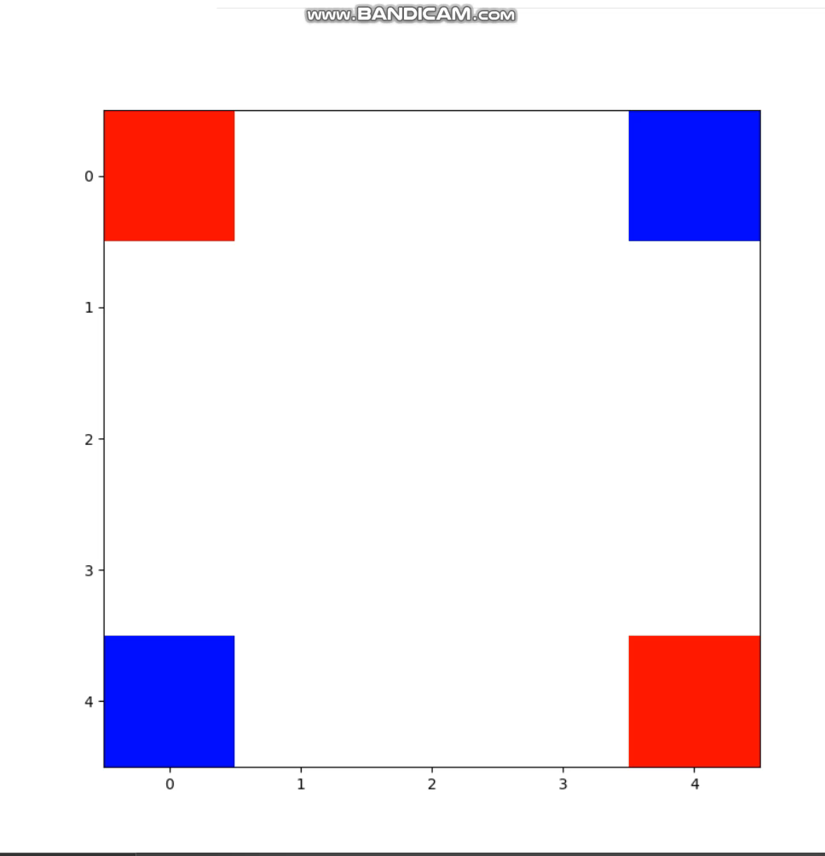
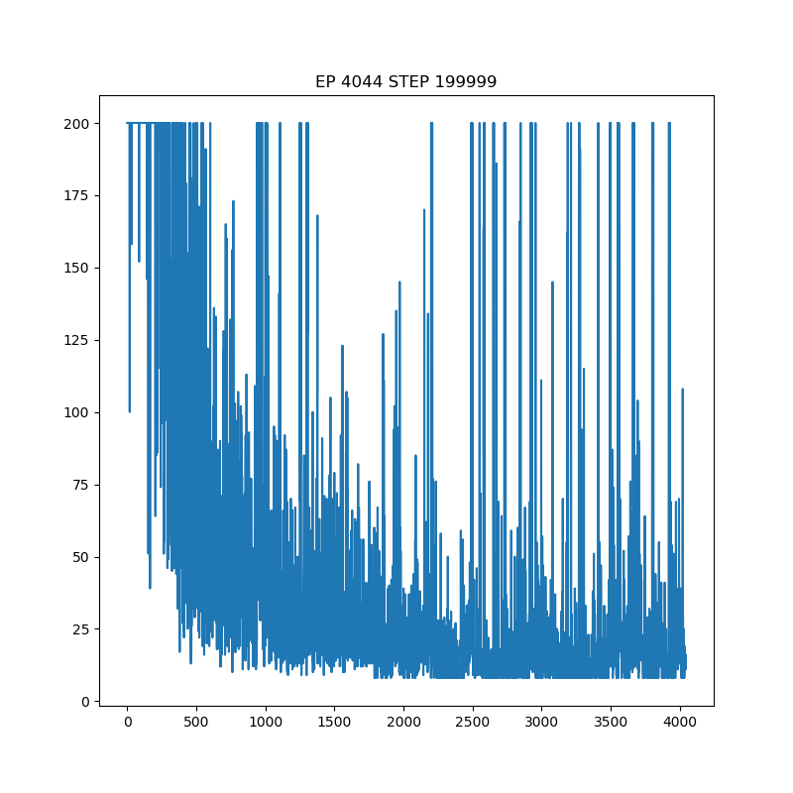
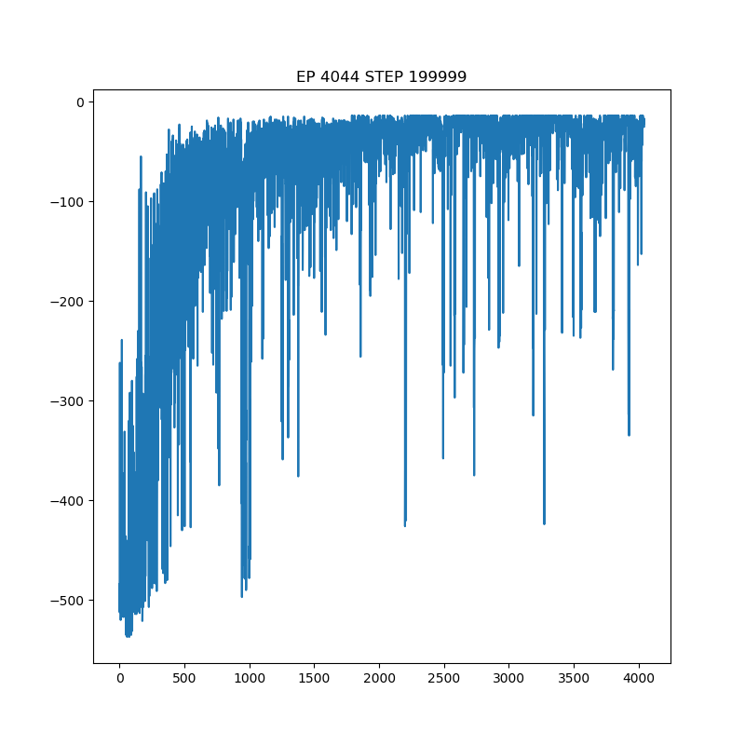
Navigate with randomized obstacle
Steps to solve
Cumulative reward
200000 training steps. 30000 replay buffer size
Epsilon linear decay until 150000 steps.
Change the obstacle every 10 episode (max 200 steps per episode).

Slide 12
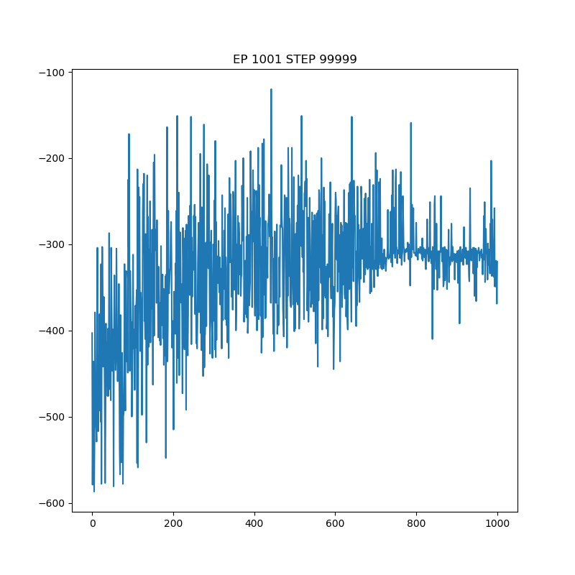
MORE AGENTS
Agents seems to learn how to avoid collision, but not learned to reach target.

Slide 13
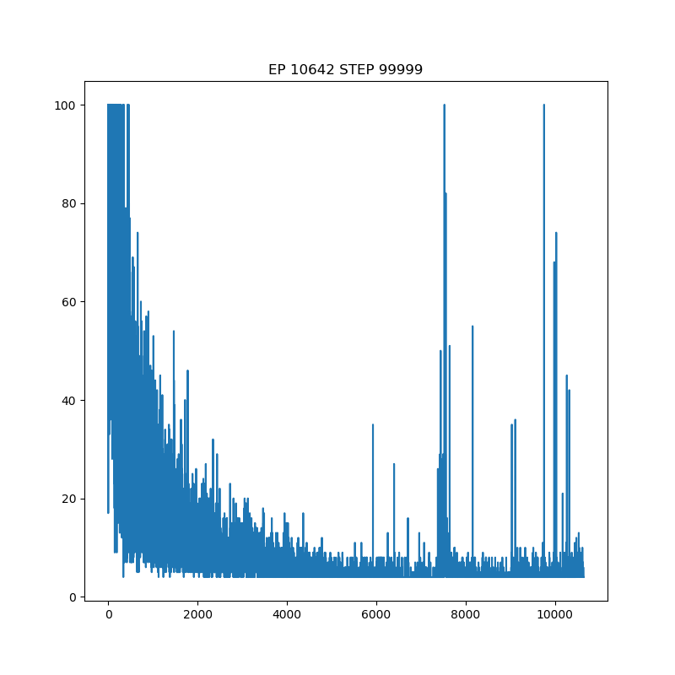
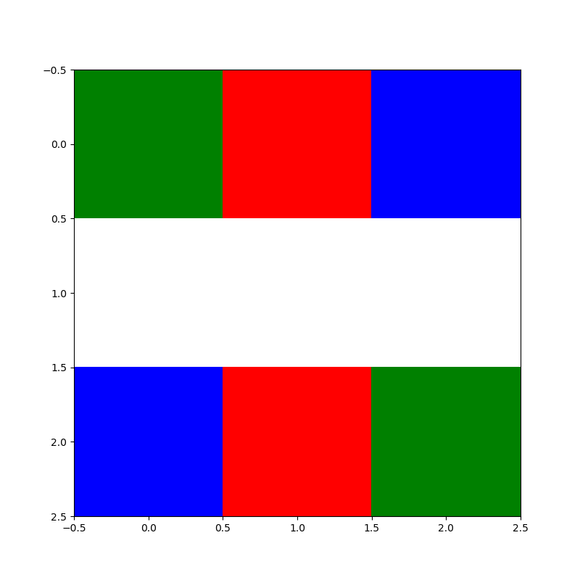
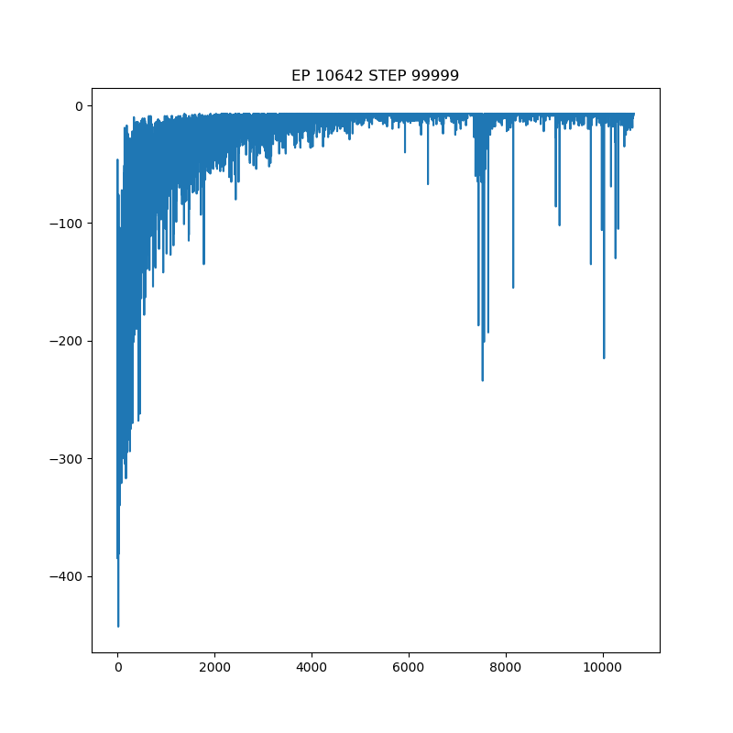
An easier version

